Slide 1
webVR
VIRTUAL REALITY BECOMING MAINSTREAM
25/01/2016
LWS LIGHTNING TALKS MARTIN JAKL @JAKLMARTIN

Slide 2
Overview
Virtual Reality is making comeback, this time with smaller and more powerful hardware.
Some Head Mounted Displays (HMD) already available, more planned for this year.
25/01/2016
LWS LIGHTNING TALKS MARTIN JAKL @JAKLMARTIN

Slide 3
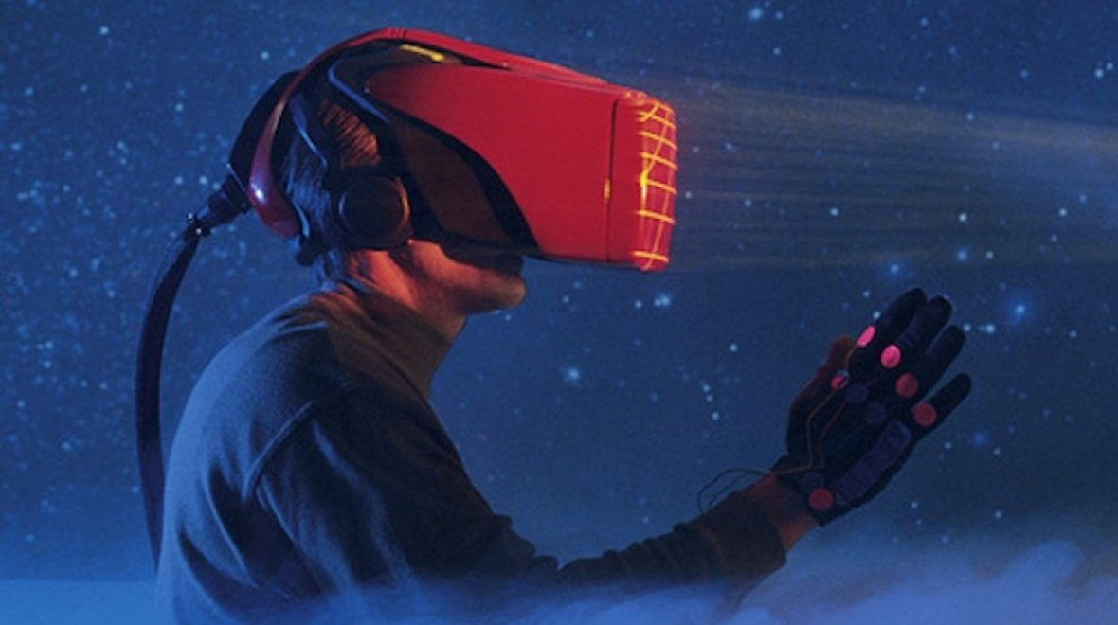
VR in the 1980s and early 90s
http://www.wareable.com/media/imager/5500-0be88426f9d4384bfc85657c77447d23.jpg
25/01/2016
LWS LIGHTNING TALKS MARTIN JAKL @JAKLMARTIN

Slide 4
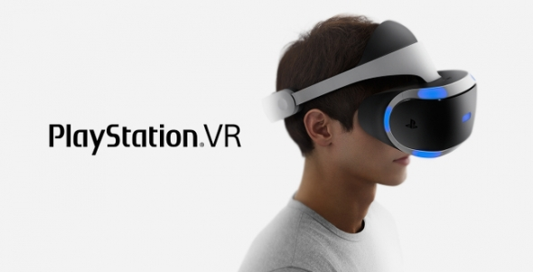
Sony’s Playstation VR
http://images.vcpost.com/data/images/full/79957/introducing-playstation-vr.jpg?w=590
25/01/2016
LWS LIGHTNING TALKS MARTIN JAKL @JAKLMARTIN

Slide 5
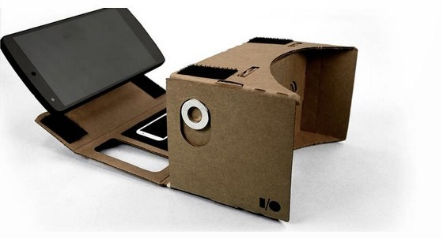
Google Cardboard VR
https://9to5google.files.wordpress.com/2014/06/slice_5_1024x1024.jpg?w=2000&h=&crop=1
25/01/2016
LWS LIGHTNING TALKS MARTIN JAKL @JAKLMARTIN

Slide 6
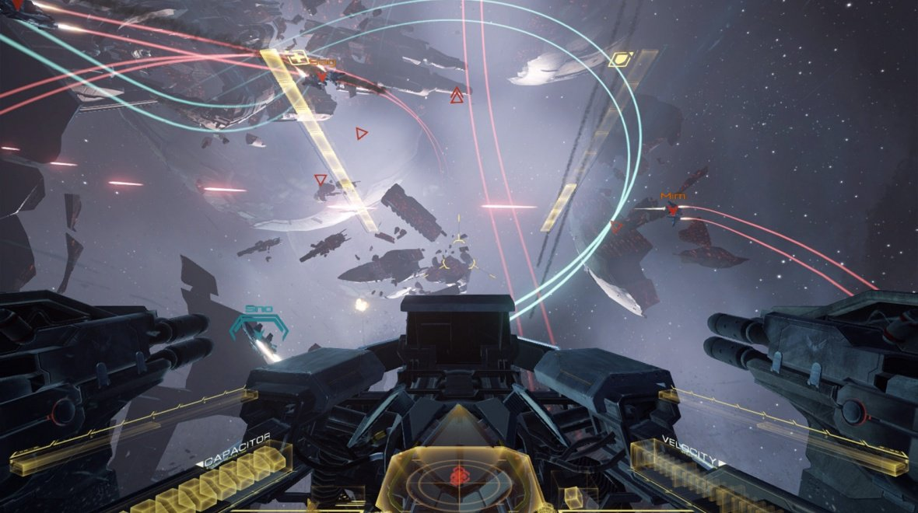
VR gaming today - EVE: Valkyrie
http://www.wareable.com/media/imager/3550-f92638f3a310dab97ace6f9cea22d20c.jpg
25/01/2016
LWS LIGHTNING TALKS MARTIN JAKL @JAKLMARTIN

Slide 7
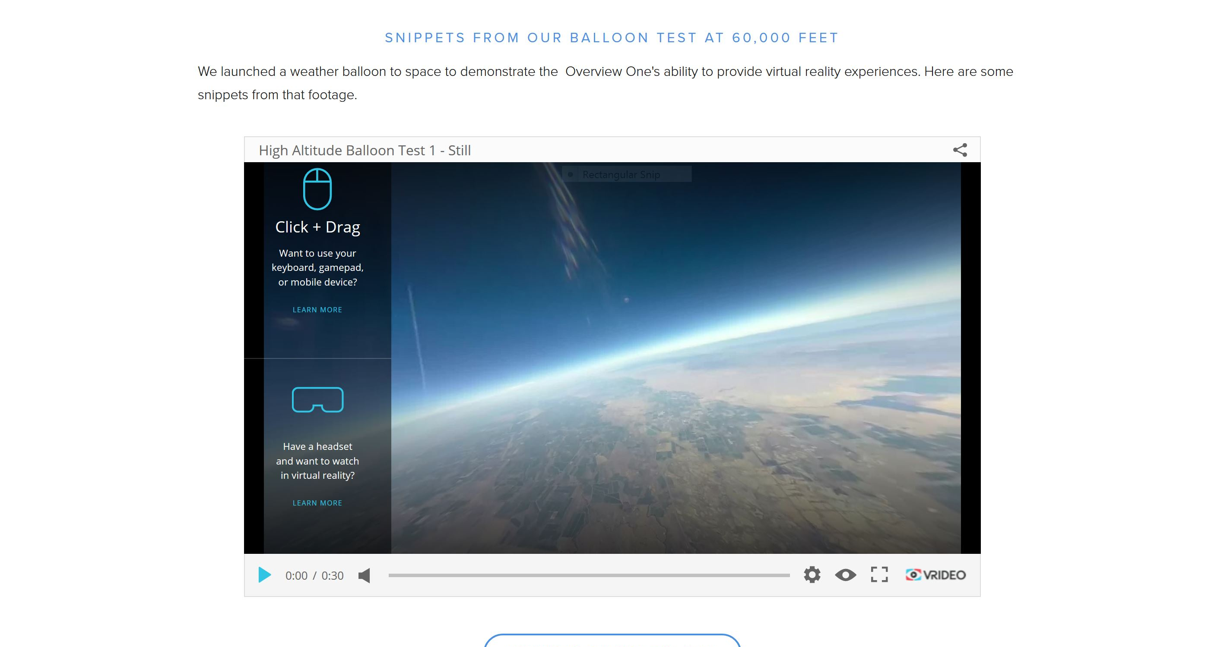
360 video - balloon test at 60,000 feet
http://www.spacevr.co/vrcontent
25/01/2016
LWS LIGHTNING TALKS MARTIN JAKL @JAKLMARTIN

Slide 8
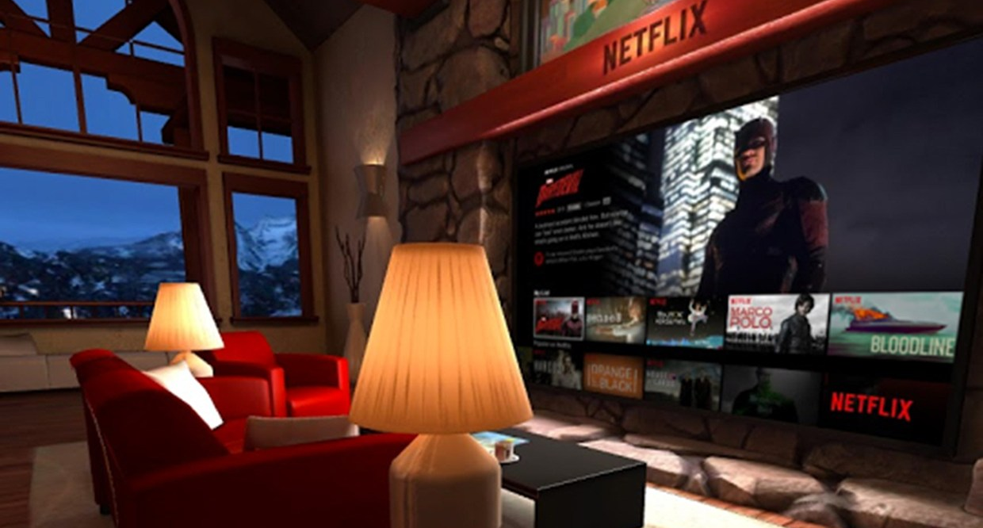
Netflix has built a VR living room
http://www.wired.co.uk/news/archive/2015-09/25/oculus-connect-2-netflix/viewgallery/541477
25/01/2016
LWS LIGHTNING TALKS MARTIN JAKL @JAKLMARTIN

Slide 9
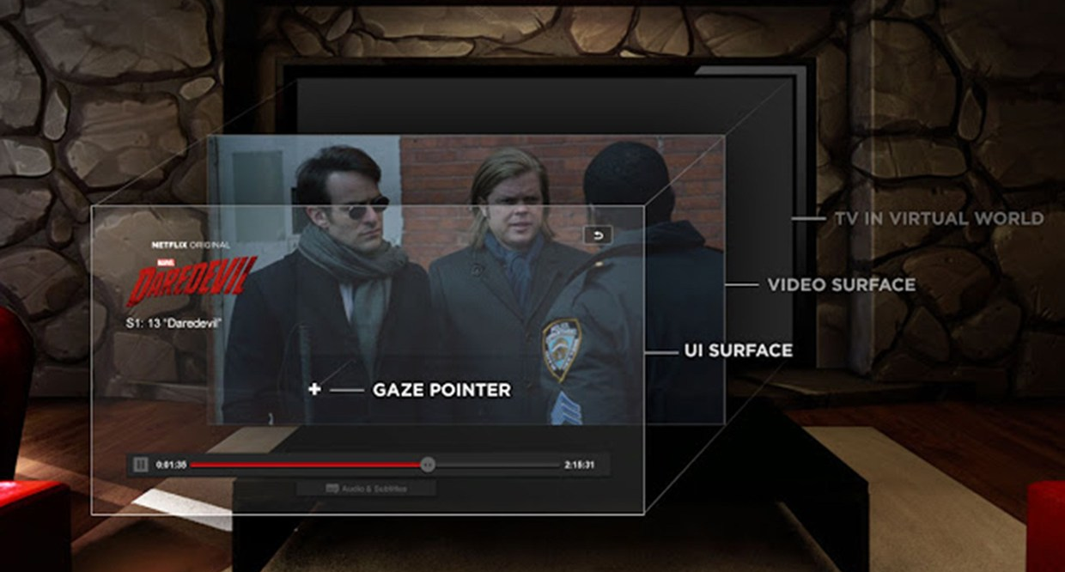
Multiple Android Surfaces – UI & video
http://www.wired.co.uk/news/archive/2015-09/25/oculus-connect-2-netflix/viewgallery/541476
25/01/2016
LWS LIGHTNING TALKS MARTIN JAKL @JAKLMARTIN

Slide 10
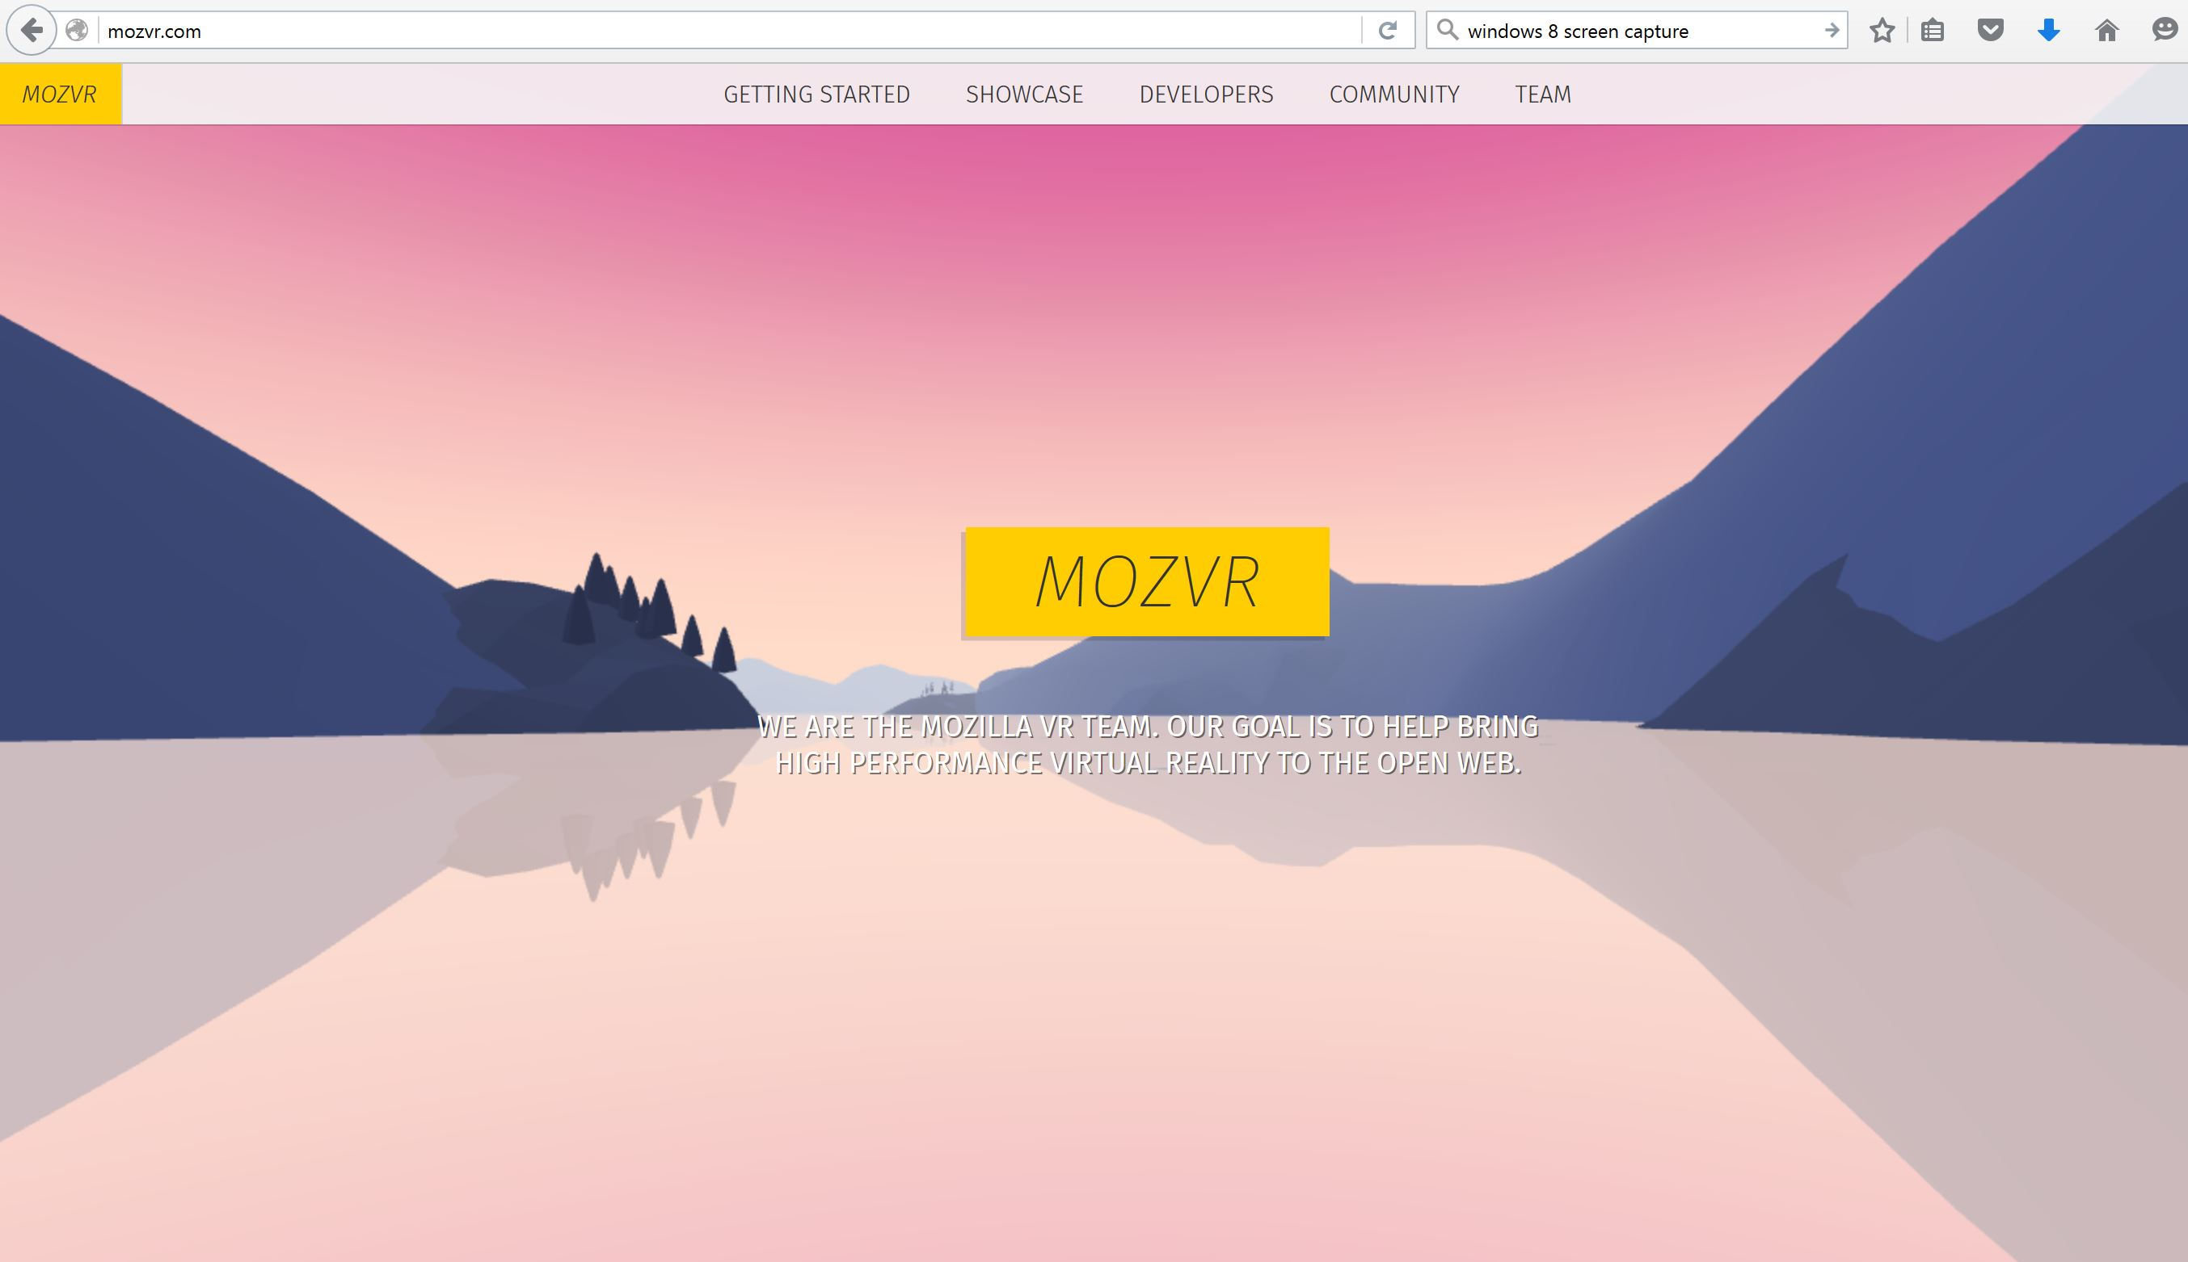
WebVR API 1.0 in Firefox Nightly
www.mozvr.com
25/01/2016
LWS LIGHTNING TALKS MARTIN JAKL @JAKLMARTIN

Slide 11
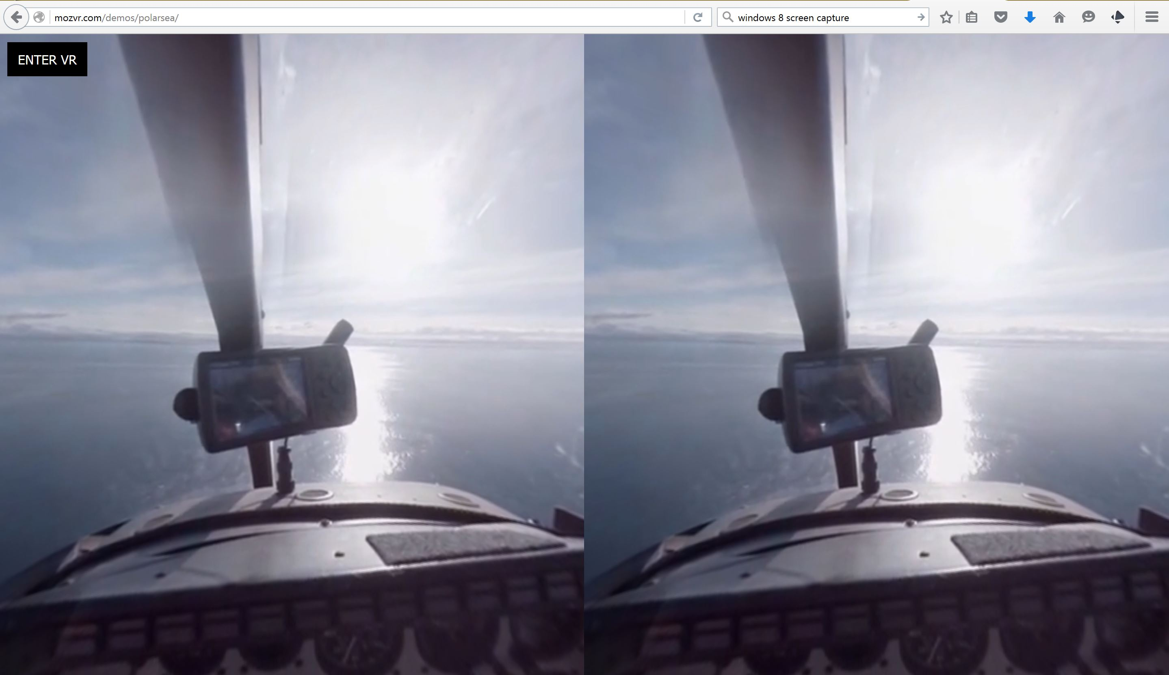
Stereoscopic rendering
http://mozvr.com/demos/polarsea/
25/01/2016
LWS LIGHTNING TALKS MARTIN JAKL @JAKLMARTIN

Slide 12
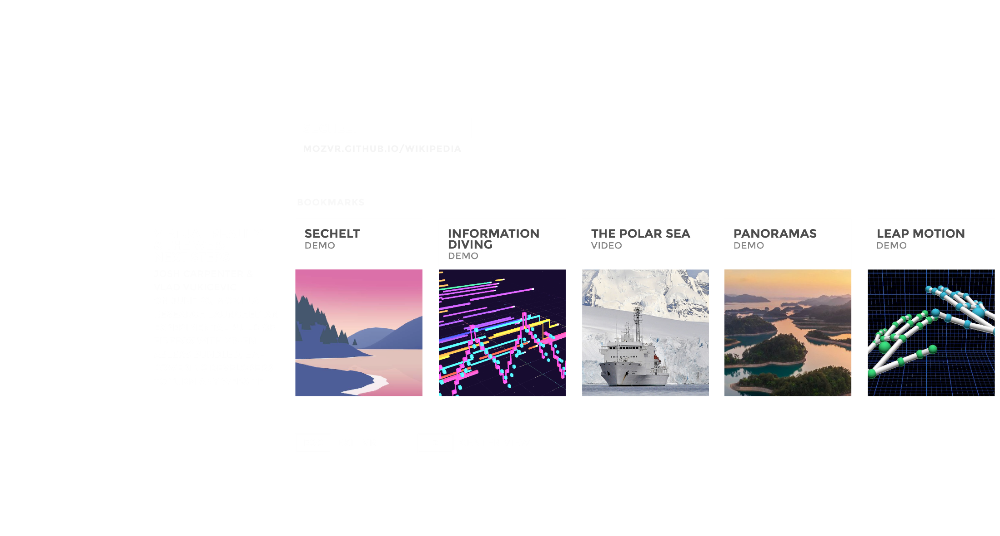
Mockups on Cylinders – ‘closed’ system
https://github.com/MozVR/vr-web-examples/blob/master/mockups-on-cylinders/images/mockup.png
25/01/2016
LWS LIGHTNING TALKS MARTIN JAKL @JAKLMARTIN

Slide 13
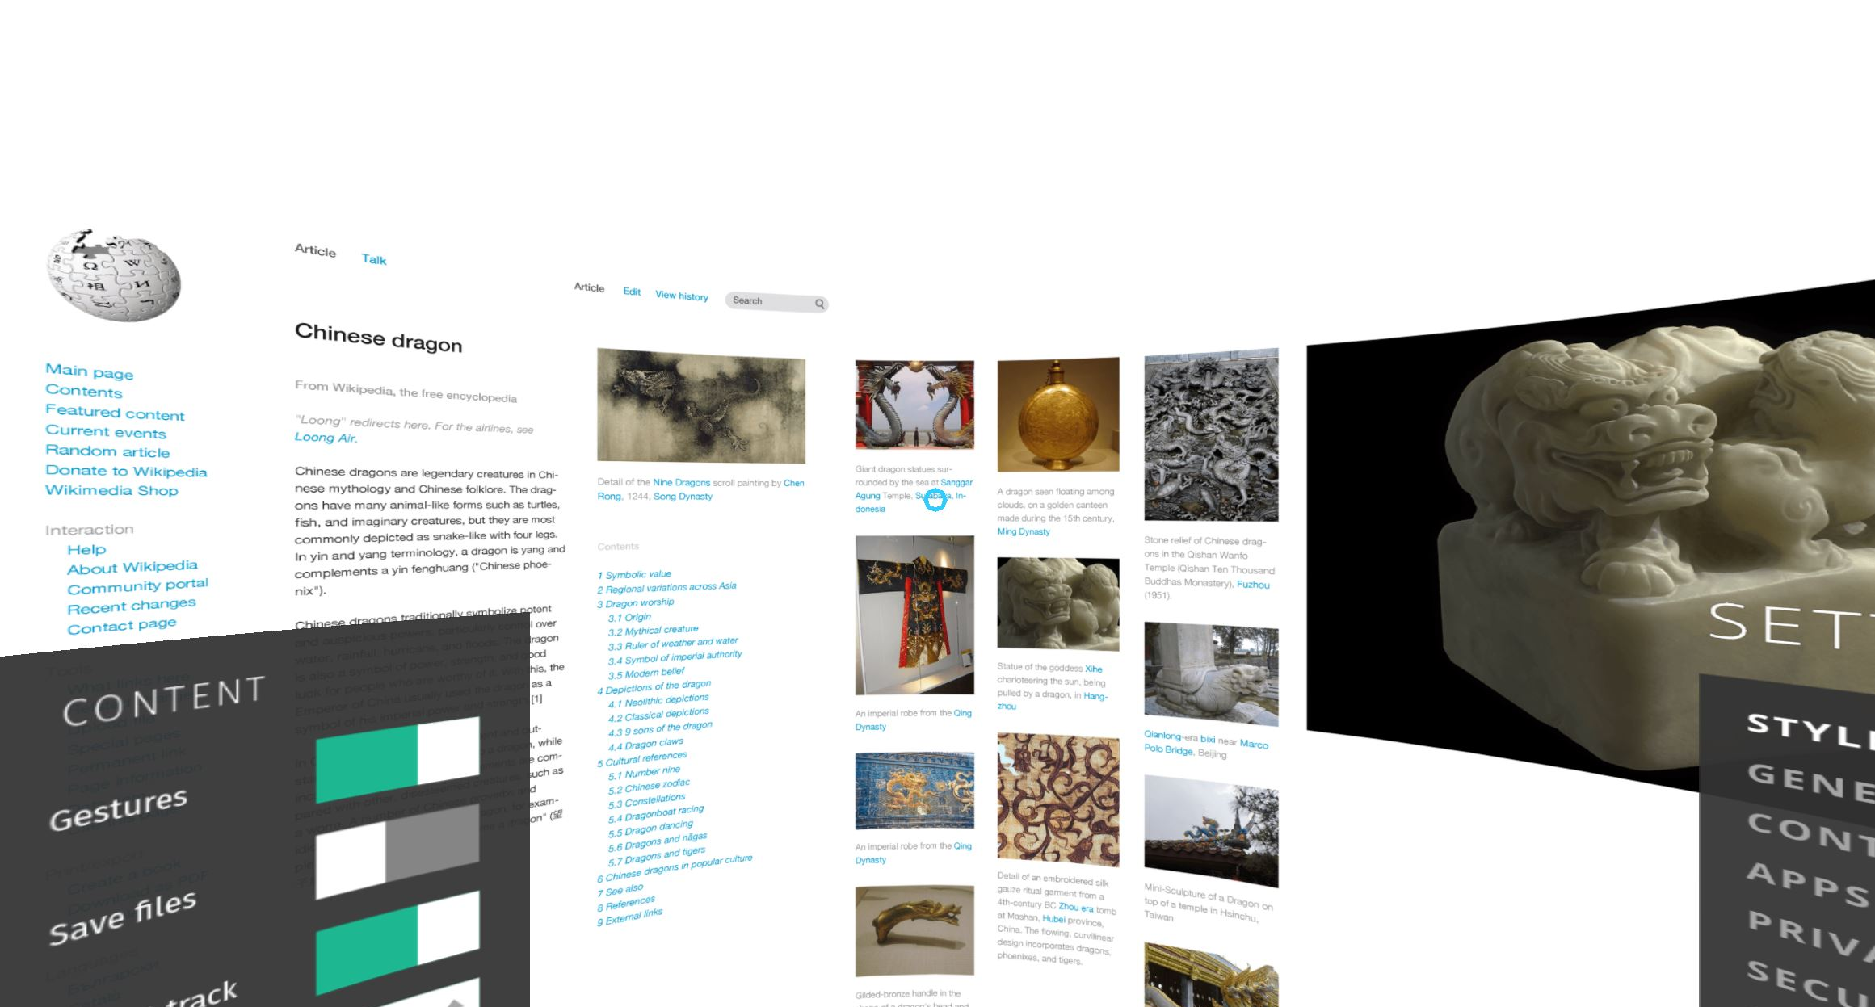
A-FRAME: Curved Mockups – ‘open’ solution
How is url link represented, how are controls implemented
https://aframe.io/examples/showcase/curved-mockups/?prev
25/01/2016
LWS LIGHTNING TALKS MARTIN JAKL @JAKLMARTIN

Slide 14
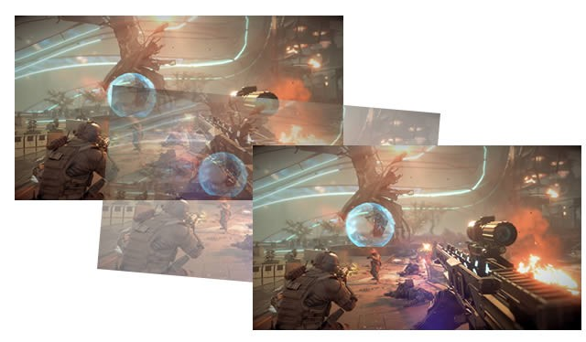
VR sickness – using reprojection and 120fps
http://ps4daily.com/wp-content/uploads/2015/03/ps4-reprojection-640x374.jpg
25/01/2016
LWS LIGHTNING TALKS MARTIN JAKL @JAKLMARTIN

Slide 15
Background
C++ developer, embedded systems and mobile OS development
Working on WebKit based webVR system supporting some of the use cases discussed (mainly video)
25/01/2016
LWS LIGHTNING TALKS MARTIN JAKL @JAKLMARTIN

